Slide 1
IOT based intelligent traffic management system
Uzakov Muktar, Nuraliyeva Assel, Kabdygaliyeva Yerkezhan

Slide 2
The Objective of the project is to make IOT based intelligent traffic management system.

Slide 3
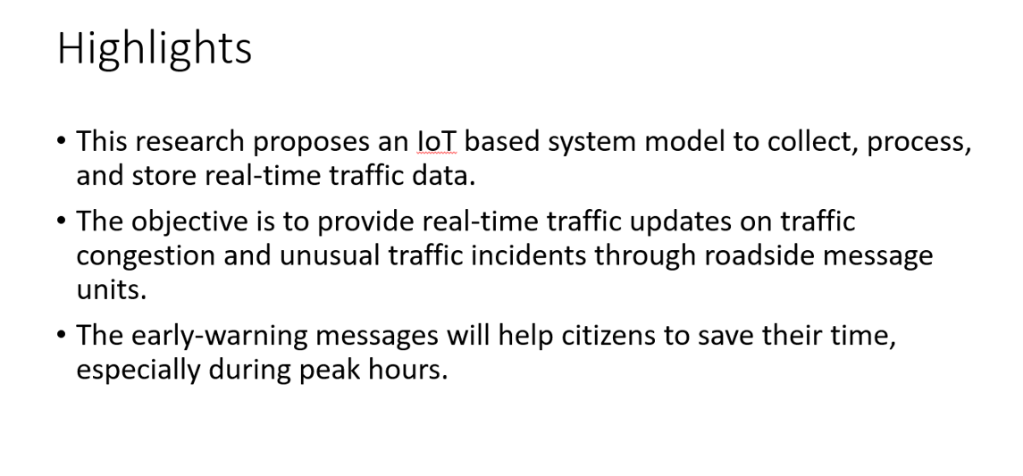

Slide 4


Slide 5
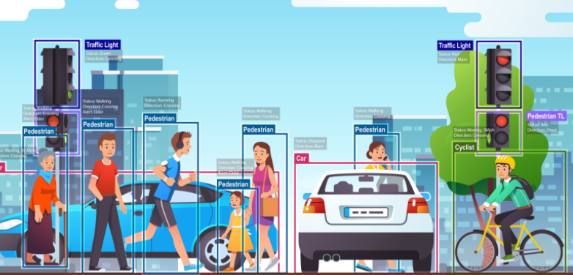
The four main system development activities are:
(i) populate geographical map details for a given location,
(ii) detect vehicle and estimate vehicle length,
(iii) determine growing queue, and
(iv) display traffic updates.

Slide 6




The system components include:
(i) Geographical map,
(ii) Sensors,
(iii) Microcontroller,
(iv) IoT platform,
(v) Database, and
(vi) Electronic display units

Slide 7
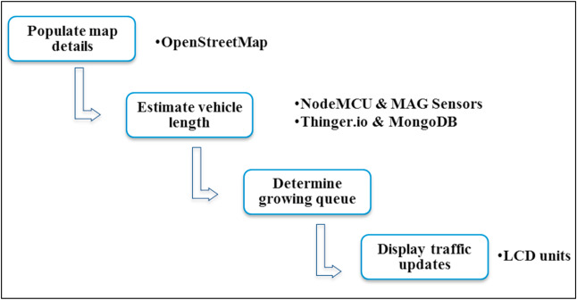
The activities, the software, and hardware components associated with each activity are shown below:

Slide 8
Algorithm:
Vehicle detection and physical length estimation
Road occupancy and growing queues
Display warning audio messages

Slide 9
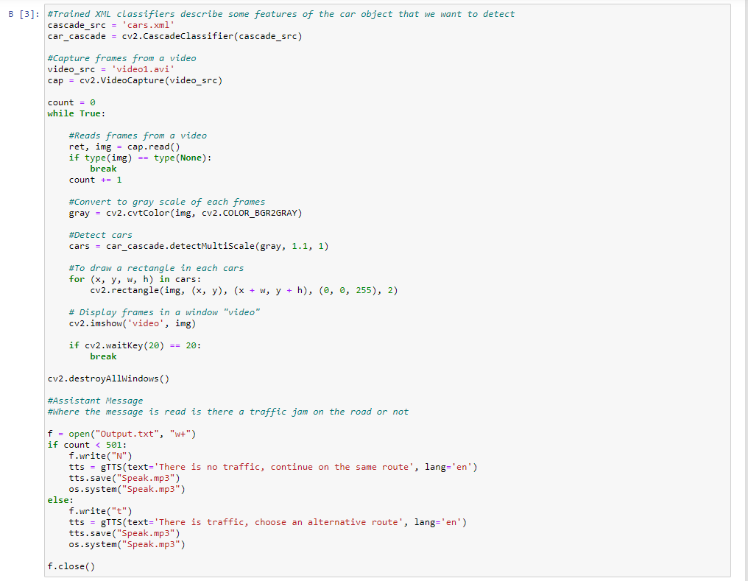
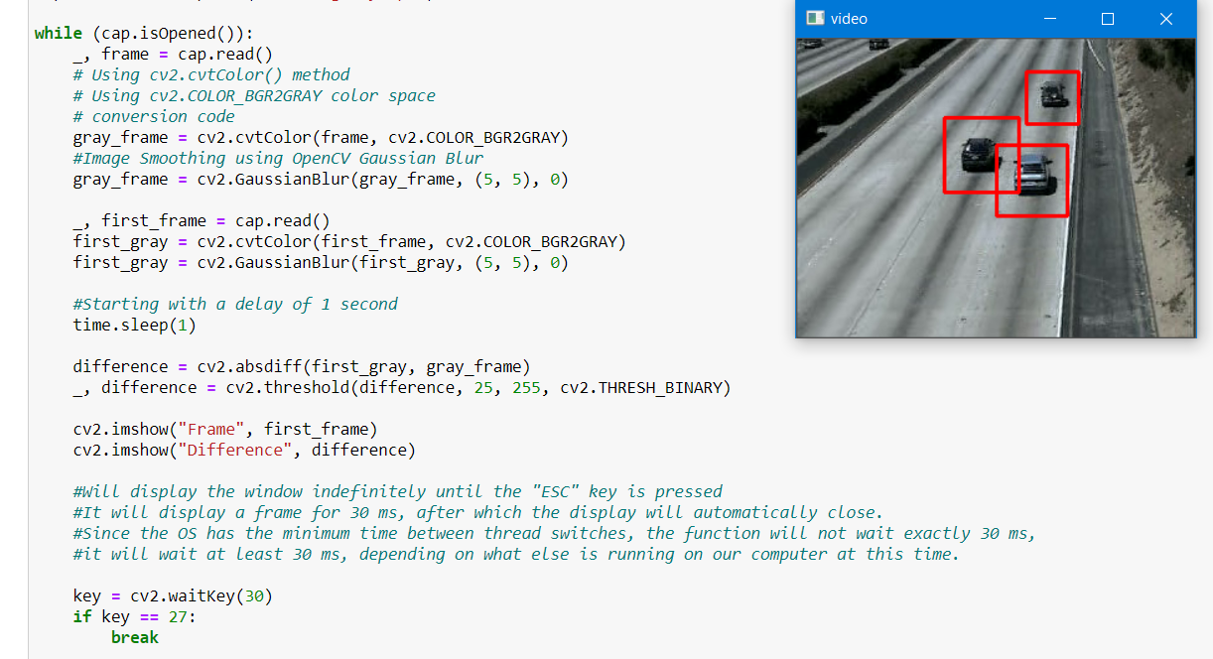
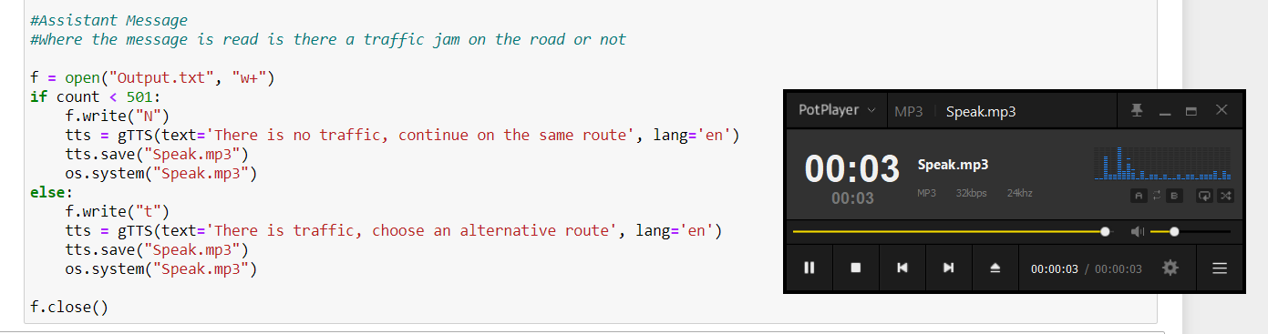

Slide 10
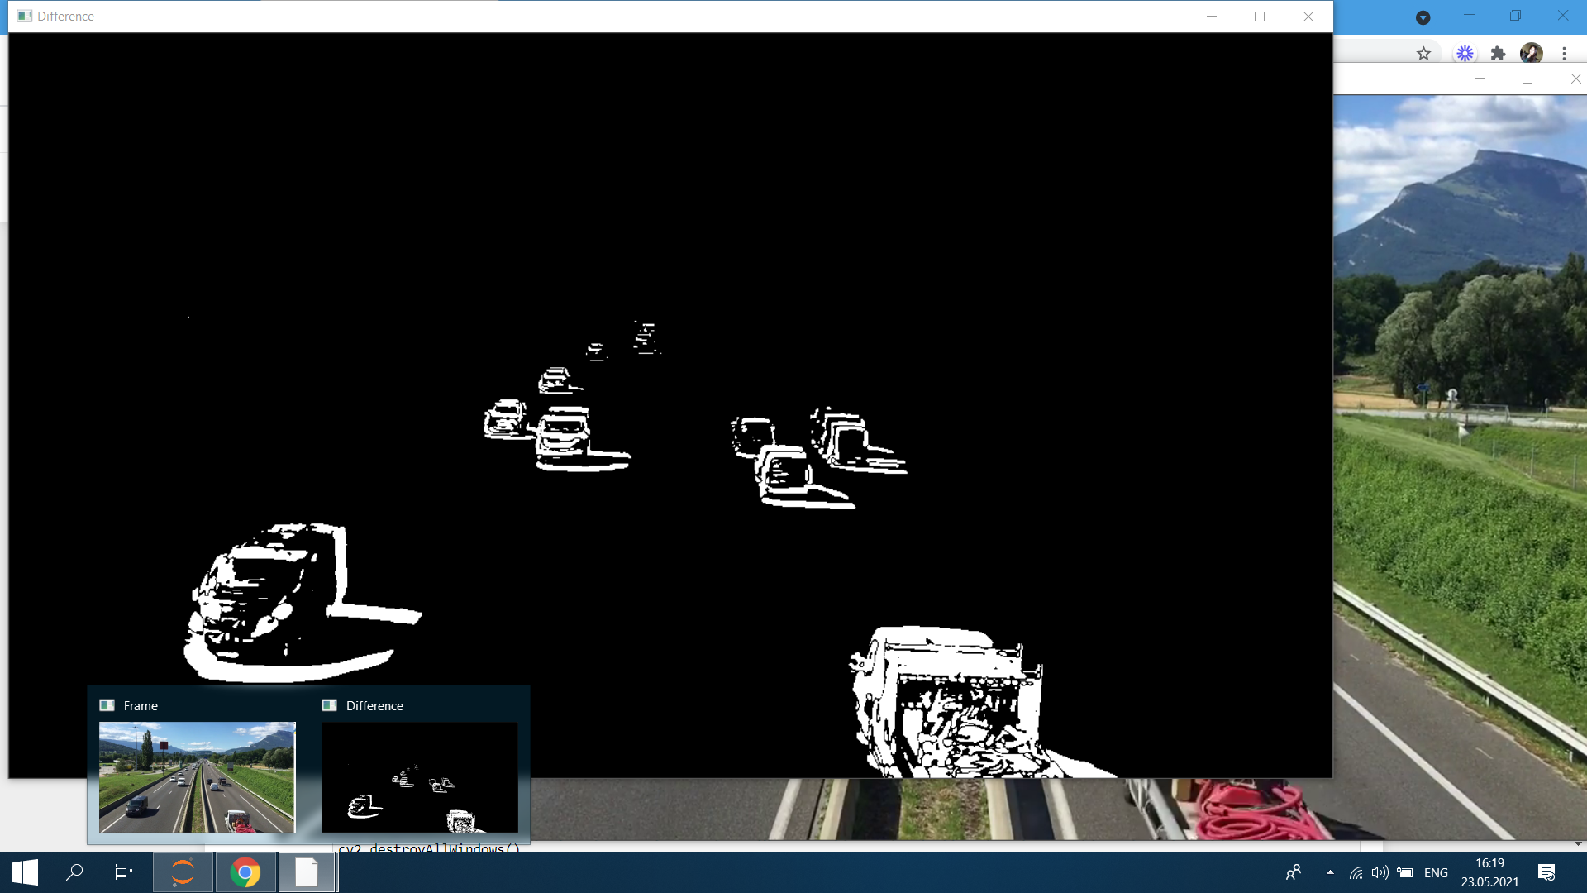
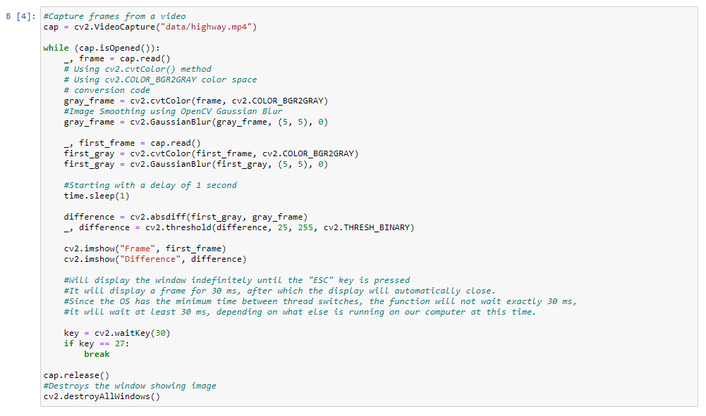
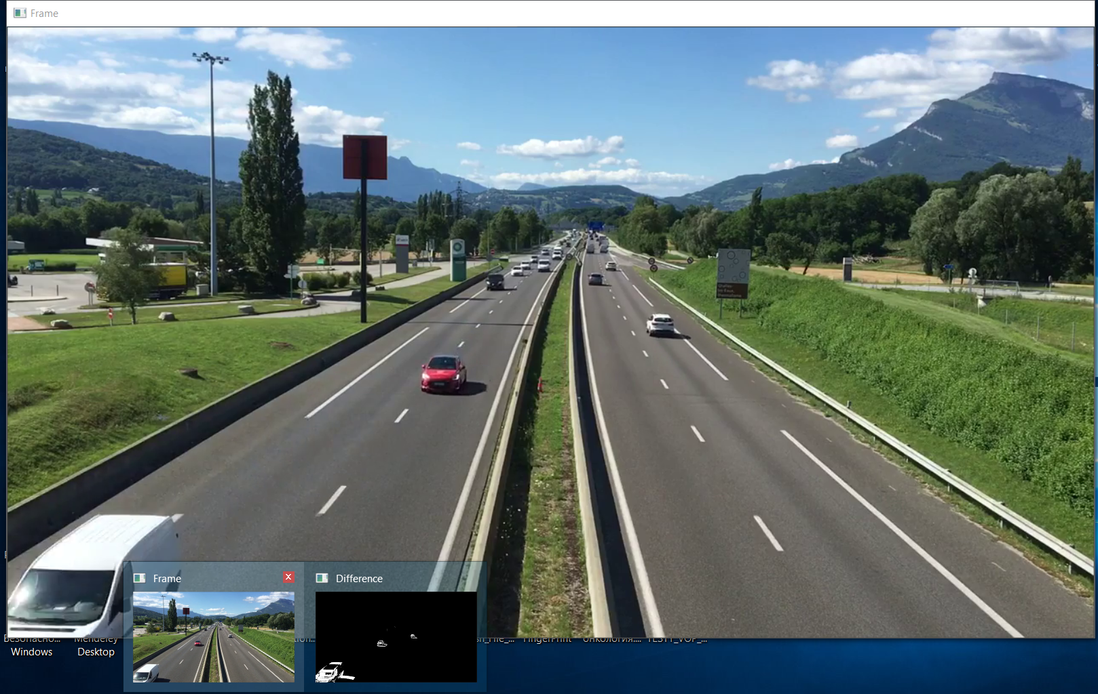

Slide 11
Thanks for the attention!

